Slide 1
Project Presentation of Back End Engineering Project (BEE) (22CS026)
On
Examination Portal
Submitted By:
Nimish Sharma-2210991986
Prabhdeep Singh-2210990250
Supervised By
Mr.Rahul Singh Rajput
Department of Computer Science and Engineering,
Chitkara University, Punjab

Slide 2
Project Statement:
In the modern education system, digital assessment platforms play a crucial role in streamlining the examination process. This project, Online Examination Platform, is designed to provide a structured and efficient way to manage online tests, ensuring seamless coordination between administrators, examiners, and students. Built using the MERN (MongoDB, Express.js, React.js, Node.js) stack, this platform enables admin users to create courses and assign them to examiners. Examiners can then create and manage tests, performing CRUD (Create, Read, Update, Delete) operations on questions.
Students can take assigned tests, and view their results upon completion. The system ensures a smooth examination process by incorporating secure authentication, automated result calculation, and real-time test management. With an intuitive user interface and a structured workflow, this platform enhances the efficiency of online assessments while maintaining transparency and accuracy.

Slide 3
Functionalities:
Admin Dashboard allows admins to manage courses, assign examiners, and oversee platform operations. Admins can create, update, and delete courses while monitoring overall system activity.
Examiner Dashboard enables examiners to create and manage tests for assigned courses. They can add, edit, and delete questions, set test schedules, and automate grading for objective questions. Examiners also have the ability to manually evaluate subjective responses and view student performance reports.
Student Dashboard provides students with access to assigned tests, allowing them to attempt exams within the scheduled timeframe. Students can view their results, track their exam history, and receive notifications for upcoming tests. In future updates, they will also have access to certificates for completed exams.
Role-based access control maintaining security and data privacy through JWT authentication. Future enhancements include cheating prevention mechanisms, graphical analytics for performance tracking, manual checking of subjective questions, real-time notifications, and automated certificate generation for successful test completion.
Registration and Authentication Sign-up/Login: Users can create accounts or log in using credentials or third-party services (e.g., Google, Facebook).User Profiles: Users can manage personal information, view travel history, and saved trips.

Slide 4
Check Points:
Does the project statement result in a product? If yes, what type of product?
Yes, the product is an examination portal.
If it is a product, can a prototype be made, if not, what is it, that we can produce that our teachers can evaluate?
Yes, a functional prototype of the website can be made for evaluation.
Does the project statement use multiple concepts to achieve the outcome? (yes/no)
yes
Does it have enough for our team members to do a sufficient amount of work? (yes / no)
yes

Slide 5
Technical Nodes
Subject / Area / Topic | Technical Nodes
Web Development | HTML, CSS, JavaScript, React.js, tailwind
Backend Development | Node.js, Express.js, MongoDB
User Authentication | JWT, Bcryptjs
Email support | Node mailer

Slide 6
Prerequisites (in terms of knowledge, concepts and material) for doing the Project:
Basic knowledge of web development (HTML, CSS, JavaScript)
Familiarity with React.js for front-end development
Understanding of backend development with Node.js and Express.js
Knowledge of databases (MongoDB)
Experience with user authentication methods

Slide 7
Material that may be required to make the project and where it might be available
Laptops/computers with internet access
Software tools: VSCode, Node.js, MongoDB (available online for free)

Slide 8
Resources available to us:
Internet access
Online tutorials and documentation
Guidance from professors and mentors

Slide 9
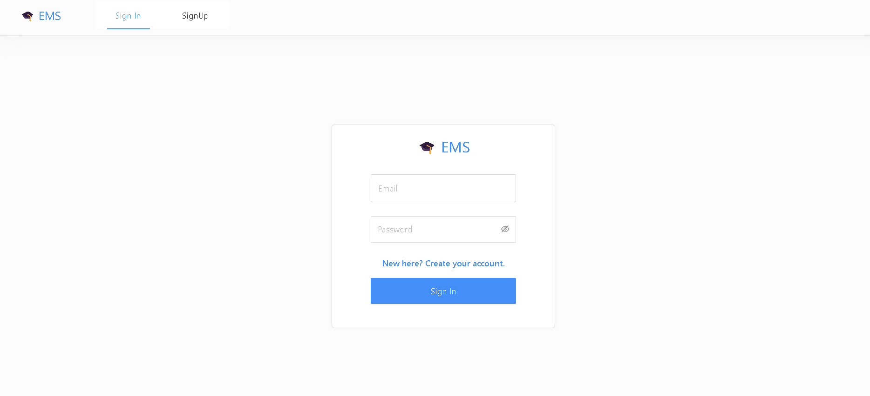

Slide 10
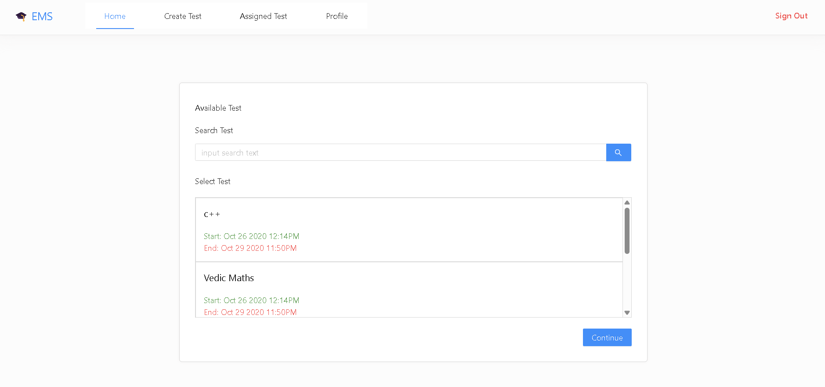

Slide 11
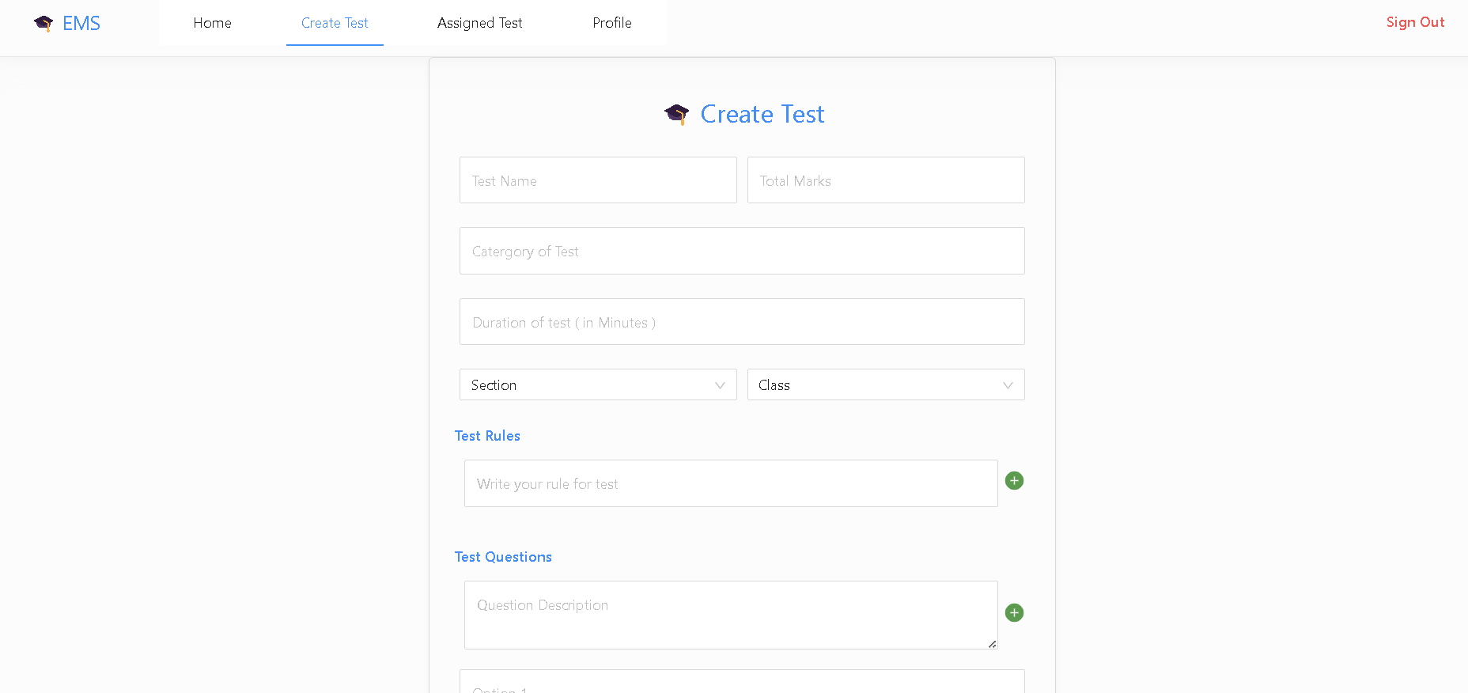

Slide 12
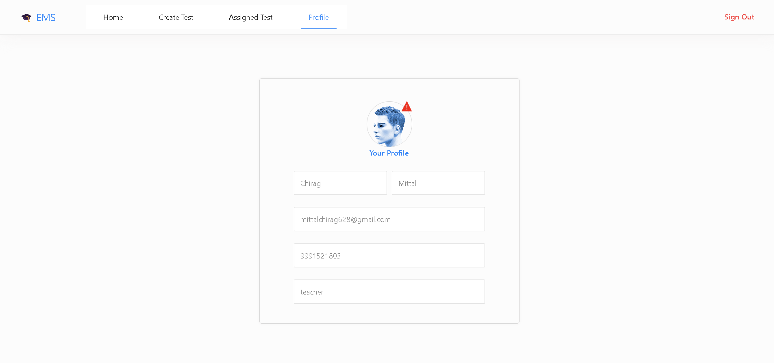

Slide 13
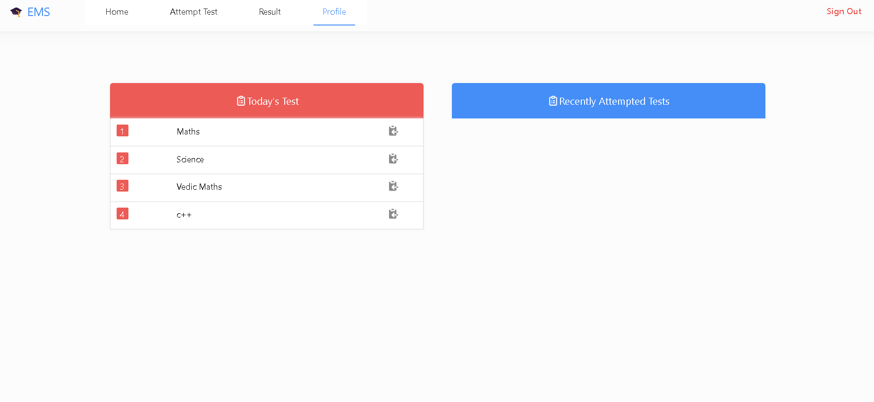

Slide 14
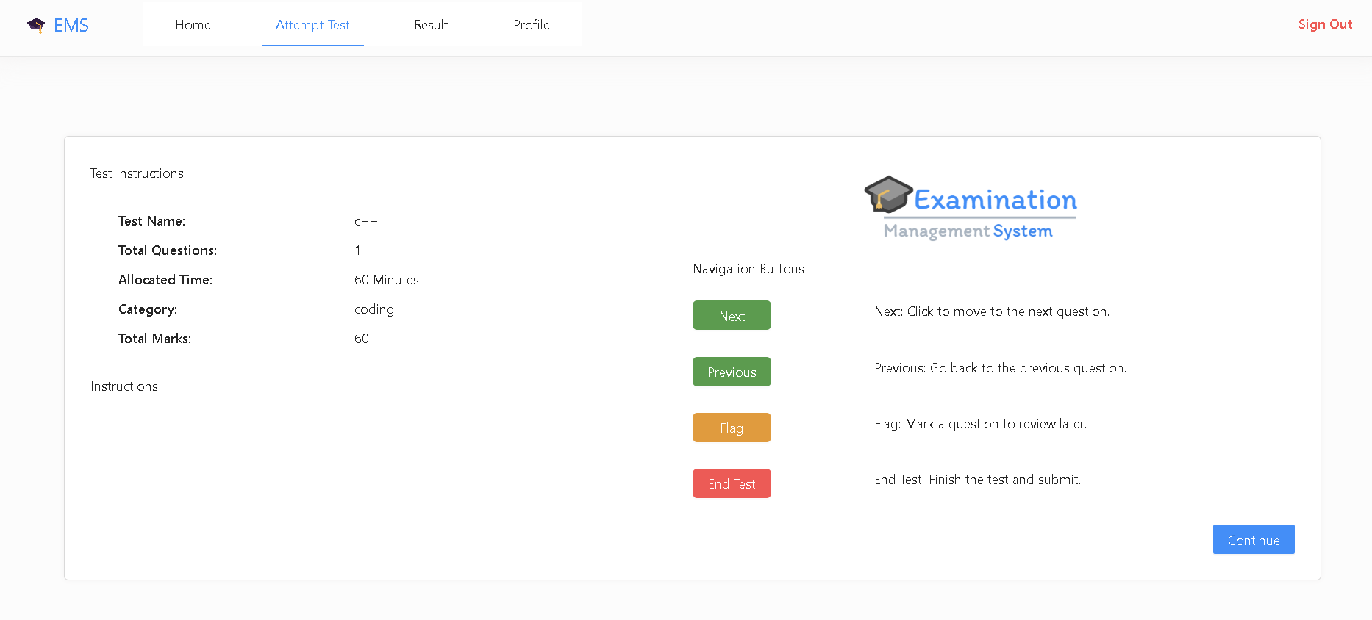

Slide 15
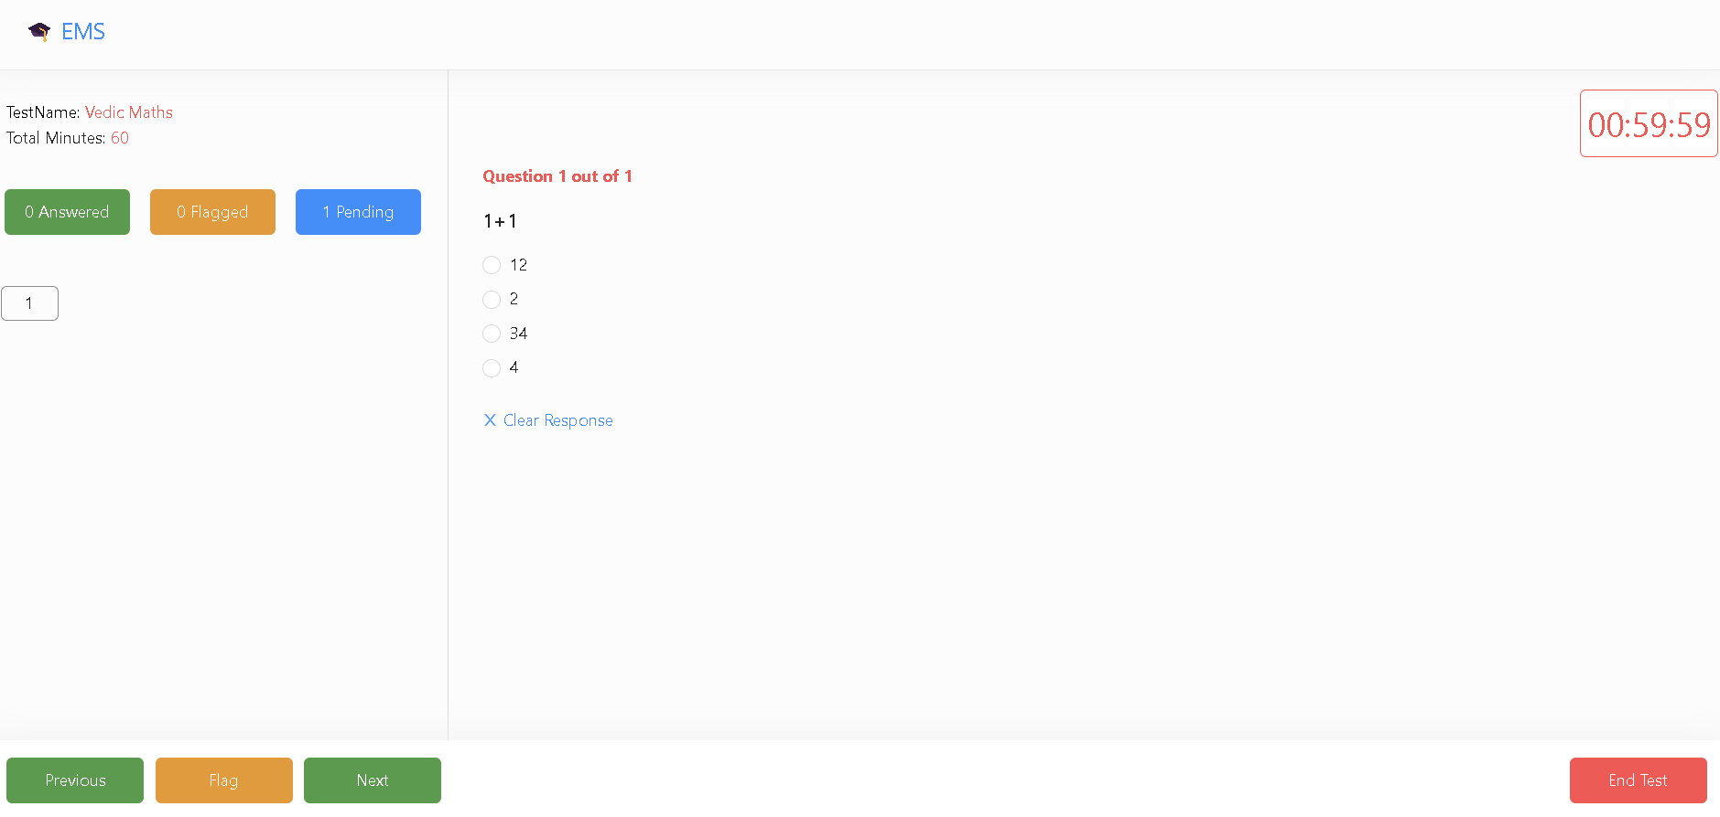

Slide 16
Future Scope:
Cheating Prevention – Implementing AI-powered proctoring, screen monitoring, and plagiarism detection to ensure fair examination practices.
Charts for Results – Enhancing the platform with graphical analytics, including bar charts and pie charts, to help students and examiners visualize performance trends over time.
Manual Checking of Questions – Introducing an option for examiners to manually evaluate subjective answers, ensuring fair grading for descriptive responses.
Notification for Tests – Implementing email and in-app notifications to remind students about upcoming tests, deadlines, and important updates.
Certificate Generation – Enabling automated certificate generation for students who successfully pass a test, with downloadable PDFs.
Exam History Tracking – Allowing students to view their past test attempts, scores, and progress over time, aiding in self-assessment and improvement.

Slide 17
Thank You
17

